Slide 1
Extraction and Linking of Ingredients from the Texts of Recipes Reviews
By
Amir Ali
Supervisor
Dr. Anna Wróblewska

Slide 2
Outlines
Motivation
Food Computing
Natural Language Processing
Text Extraction and Linking
Named Entity Recognition
Data Annotation
Data Collection
System Architecture
Demonstration

Slide 3
Motivation
My research interest is mainly focused on Natural Language Processing.
Explore Food Computing Domain
Ingredient Knowledge
Applications in Health Sector
Investigate the Named Entity Recognition Techniques
Future Study Plan: Build an Automatic Data Annotation system

Slide 4
Food Computing
Food computing is a multidisciplinary field that combines computer science, engineering, and the culinary arts to create innovative solutions for problems related to food and cooking.
Food informatics and data analytics: Using computer science and statistical techniques to analyze and visualize data related to food and cooking, such as nutritional information[1], ingredient substitutions [2], or cooking time estimates [3].
[1] Toledo, R. Y., Alzahrani, A. A., & Martinez, L. (2019). A food recommender system considering nutritional information and user preferences.
IEEE Access, 7, 96695-96711.
[2] Ławrynowicz, A., Wróblewska, A., Adrian, W. T., Kulczyński, B., & Gramza-Michałowska, A. (2022). Food Recipe Ingredient Substitution Ontology Design Pattern. Sensors, 22(3), 1095.
[3] Diaz, S., Ariza-Suarez, D., Ramdeen, R., Aparicio, J., Arunachalam, N., Hernandez, C., ... & Raatz, B. (2021). Genetic architecture and genomic prediction of cooking time in common bean (Phaseolus vulgaris L.). Frontiers in plant science, 11, 622213.

Slide 5
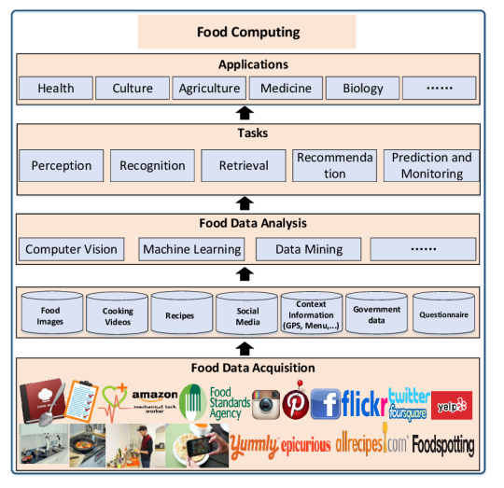
Figure 1: An overview of food computing [4]
[4] Min, W., Jiang, S., Liu, L., Rui, Y., & Jain, R. (2019). A survey on food computing. ACM Computing Surveys (CSUR), 52(5), 1-36.

Slide 6
Natural Language Processing (NLP)
NLP is the use of computational methods to understand and process human language data, such as text or speech.
It has many applications, including
Machine translation
Information retrieval
Speech recognition

Slide 7
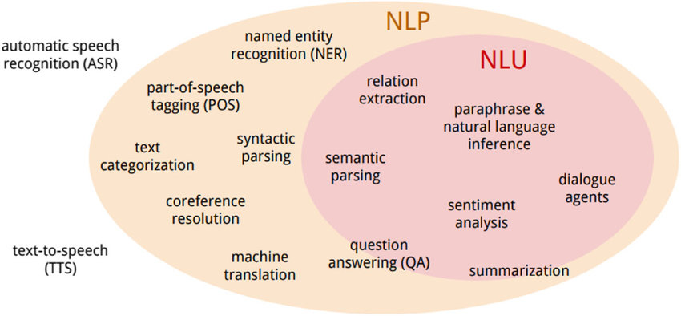
Figure 2: Terminology of NLU versus NLP [5]
[5] McShane, M. (2017). Natural language understanding (NLU, not NLP) in cognitive systems. AI Magazine, 38(4), 43-56.

Slide 8
Text Extraction and Linking
Text extraction and linking refer to the process of extracting relevant information from texts and linking it to corresponding entries in a knowledge base or a database.
Example:
“Barack Obama was born in Hawaii on August 4, 1961.”

Slide 9
Named Entity Recognition (NER)
Named entity recognition is the task of identifying and classifying named entities, such as people, organizations, locations, and events, in text.
NER systems typically use a combination of rule-based and statistical approaches to identify and classify named entities in text.
They may use dictionaries, regular expressions, or machine learning algorithms to recognize and classify the named entities.
It is often used in information extraction and information retrieval applications.

Slide 10
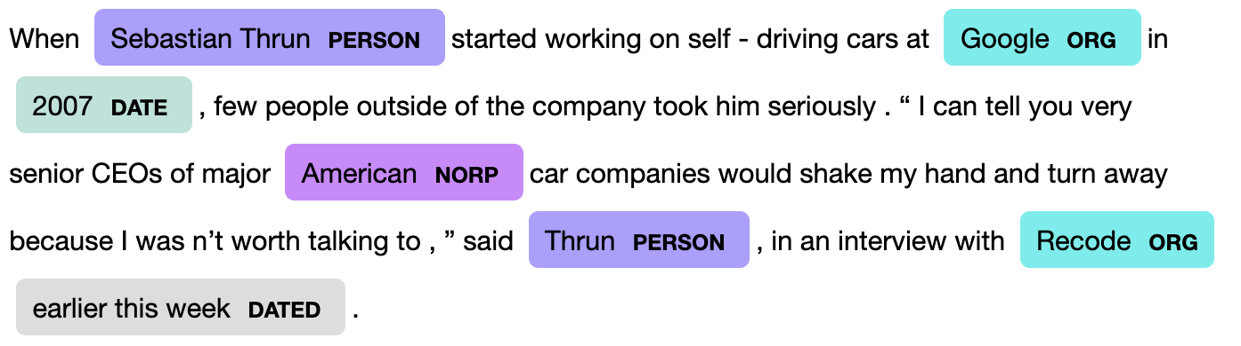
Example of Extraction Person, Org, Date using NER [6]
[6] Liao, W., & Veeramachaneni, S. (2009, June). A simple semi-supervised algorithm for named entity recognition. In Proceedings of the NAACL HLT 2009 Workshop on Semi-Supervised Learning for Natural Language Processing (pp. 58-65).

Slide 11
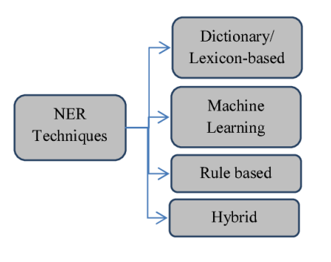
NER Techniques
Figure 3: Categorization of NER techniques [7]
[7] S. Keretna, C. P. Lim, and D. C. Creighton, “A hybrid model for named entity recognition using unstructured medical text,” 2014 9th International Conference on System of Systems Engineering (SOSE), pp. 85–90, 2014.

Slide 12
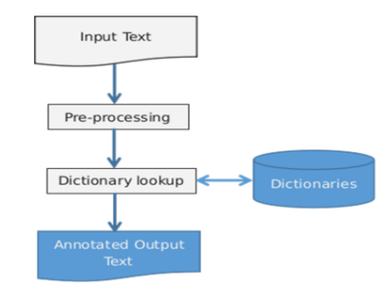
Dictionary Based
Figure 4: Dictionary-based NER Architecture [8]
[8] R. Momand, S. Waseeb, and A. M. L. Rai, “A comparative study of dictionary-based and machine learning-based named entity recognition in pashto,” in Proceedings of the 4th International Conference on Natural Language Processing and Information Retrieval, NLPIR 2020, (New York, NY, USA), p. 96–101, Association for Computing Machinery, 2021.

Slide 13
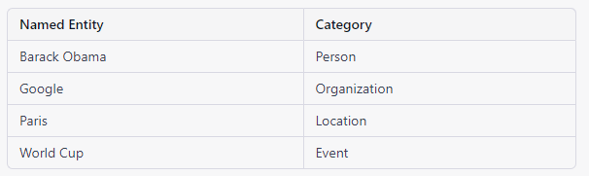
Example of Dictionary
Table 1: Dictionary
"Barack Obama is the CEO of Google. He lives in Paris. He is a fan of soccer and is looking forward to the next World Cup."

Slide 14
Rule Based
A rule-based named entity recognition (NER) system is a method for identifying and classifying named entities in text using a set of pre-defined rules.
The rules specify how to recognize and classify specific words, phrases, or structures in the text as named entities.

Slide 15
Example of Rule Based
For example, a rule-based NER system might have the following rules:
A word that starts with a capital letter and is not a common noun is a named entity of type "person."
A word that starts with "The" and is followed by a common noun is a named entity of type "organization."
A word that is all capital letters is a named entity of type "location."

Slide 16
Machine Learning
These algorithms are trained on annotated data, which is text that has been manually labeled with the named entities and their categories.
The data is used to learn patterns and correlations between the text and the named entities, which are then encoded in the model as weights and biases.
Once the model is trained, it can be used to classify new text by applying the learned patterns and correlations to the text.
Machine learning-based NER can produce high-quality results, but it requires a large amount of annotated data to train.

Slide 17
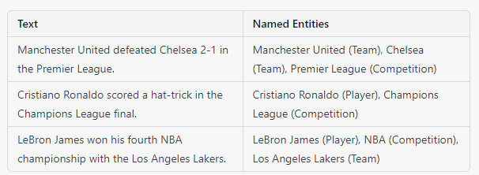

Example of Machine Learning Based NER
"Tiger Woods won the Masters tournament for the fifth time."
Notes:
The model would learn patterns and correlations between the text and the named entities, and encode them in the form of weights and biases.

Slide 18
Hybrid
Involve two or more techniques
Dictionary-based
Machine learning
Rule-based
Hybrid NER can provide high-quality results, but it can also be more complex to implement and maintain than single-technique NER

Slide 19
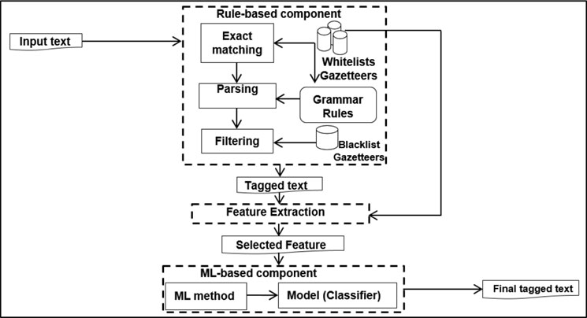
Figure 5: Architecture of Hybrid NER based on Rule and ML[9]
[9] Ramachandran, R., & Arutchelvan, K. (2021). Named entity recognition on bio-medical literature documents using hybrid based approach. Journal of Ambient Intelligence and Humanized Computing, 1-10.

Slide 20
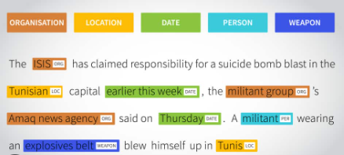
Main Challenge in NER
One of the key challenges is the annotated data to train the NER model.
Figure 5: Annotation Example [10]
[10] Di Mitri, D., Schneider, J., Klemke, R., Specht, M., & Drachsler, H. (2019, March). Read between the lines: An annotation tool for multimodal data for learning. In Proceedings of the 9th international conference on learning analytics & knowledge (pp. 51-60).

Slide 21
Data Annotation
Data annotation for named entity recognition (NER) involves labeling the named entities in the text with their corresponding categories, such as person, location, organization, etc.
Data annotation is typically done manually by a human annotator, but it can also be done using crowdsourcing or automatic methods such as active learning or semi-supervised learning.

Slide 22
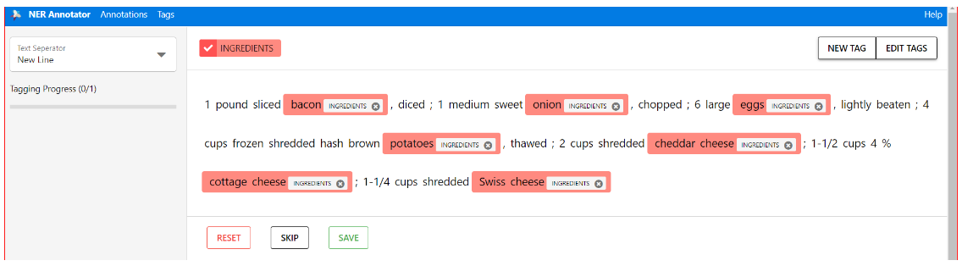
Manually Data Annotation
This can be done manually by a person.
Data annotation can be time-consuming, but it is often necessary for building accurate machine-learning models.
Figure 7: Adding annotations - NER Annotator interface [11]
[11] https://tecoholic.github.io/ner-annotator/

Slide 23
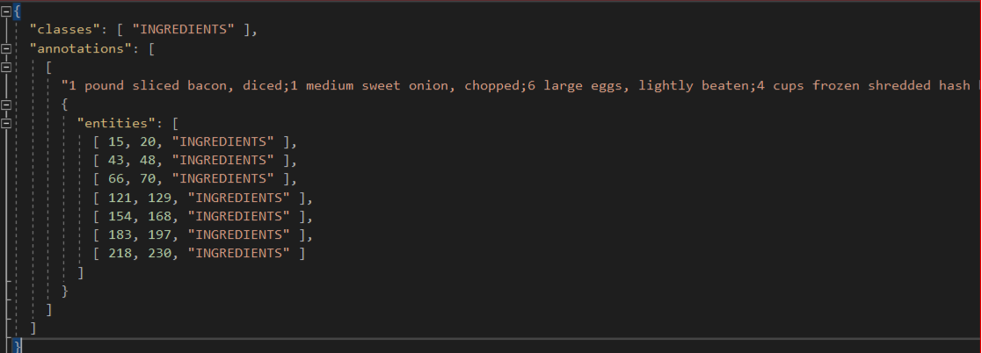
Output of manually data annotation
Figure 8: Adding annotations - an output JSON file

Slide 24
Crowdsourcing Data Annotation
Crowdsourcing is a method of outsourcing tasks or works to a large group of people, usually through the Internet, to accomplish a goal or a project.
But some limitation
Quality: The quality of the annotations may vary depending on the expertise, motivation, and attention of the crowd workers.
Security: Crowdsourcing may involve handling sensitive or personal data, which may pose privacy and security risks.

Slide 25
Automatic Method for Data Annotation
Automatic methods for data annotation involve using machine learning algorithms or techniques to label the data without human intervention
Automatic methods can be used to annotate data for named entity recognition (NER) to reduce the amount of human effort and cost required for manual annotation.
There are several ways:
Active learning
Semi-supervised learning
Rule-based systems
Dictionary-based systems

Slide 26
Data Collection
TASTEset Dataset [12]
FoodReview Dataset [13]
What Cooking Dataset [14]
[12] Wróblewska, A., Kaliska, A., Pawłowski, M., Wiśniewski, D., Sosnowski, W., & Ławrynowicz, A. (2022). TASTEset--Recipe Dataset and Food Entities Recognition Benchmark. arXiv preprint arXiv:2204.07775.
[13] https://www.tasteofhome.com/collection/our-100-highest-rated-recipes-ever/
[14] Malladi, Rajavardhan. "Recipe search engine using Yummly API." (2016).

Slide 27
TASTEset Dataset
A total of 700 sets of ingredients from recipes were manually annotated using BRAT annotation tool.
The manual annotation covered 3,788 ingredients of varying complexity
Identified entities such as:
Food
Quantity
Unit
Process
Taste

Slide 28
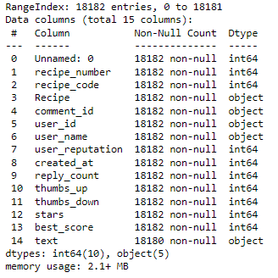
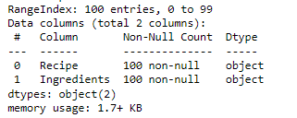
FoodReview Data
This Dataset is about Recipes Reviews and Ingredients.
Recipes Ingredients
Recipes Review

Slide 29
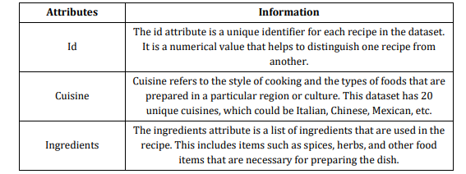
What Cooking Dataset
Dataset, focused specifically on ingredients used in different cuisines.
Dataset includes a list of ingredients that are commonly used in a particular type of cuisine, such as Italian or Chinese.
Table 1: Attribute-based Information [15]
[15] Ali, Amir & Wróblewska, Anna. (2022). HAN TO PREDICT CUISINE FROM RECIPES INGREDIENTS. International Research Journal of Modernization in Engineering Technology and Science. 4. 1835-1842. 10.56726/IRJMETS32662.

Slide 30
Data Preprocessing
Lower case
StopWords
Remove Unnecessary Words from Reviews
Stemming
Derived word into root words For instance, both “tomatoes” and “Tomato” are output as “tomato”. The purpose is to categorize into 1 word.
FoodReview needs to be Data Annotation
For this purpose:
Automatic method
Dictionary-based approach
What cooking
Ingredient feature

Slide 31
Proposed Model
Machine Learning Based NER
Spacy NER model
Bert Model
Transformer
Hybrid Based NER
Dictionary Based + Machine Learning
Rule Based + Machine Learning

Slide 32
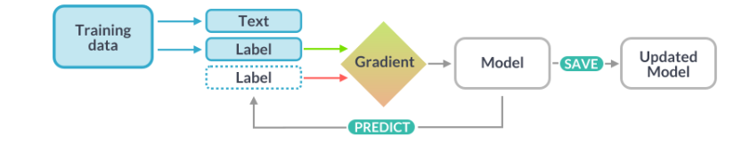
Spacy NER model
SpaCy is a popular open-source natural language processing (NLP) library for Python that provides tools and libraries for various NLP tasks, including named entity recognition (NER).
The spaCy NER model is a machine learning-based model that is trained to identify and classify named entities in texts.
Figure 9: Spacy NER model [16]
[16] https://spacy.io/usage/training

Slide 33
Demonstration
Recipes Review:
I made this recipe last night and it was delicious! I followed the instructions and used the listed ingredients, but I also added some cumin and chili powder to give it a little extra kick. I would highly recommend doing that. The chicken and beef was tender and the sauce had a great flavor. I served it over rice and it was a hit with my family. I will definitely be making this recipe again.

Slide 34
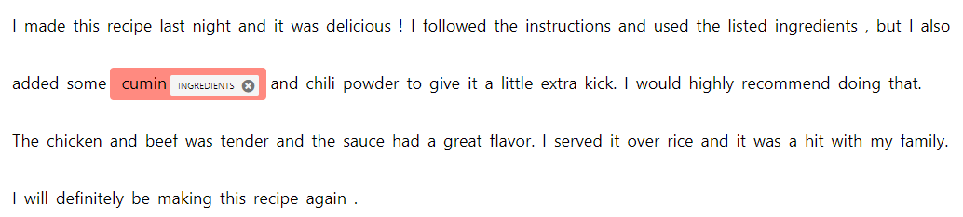
Ingredients Extraction

Slide 35
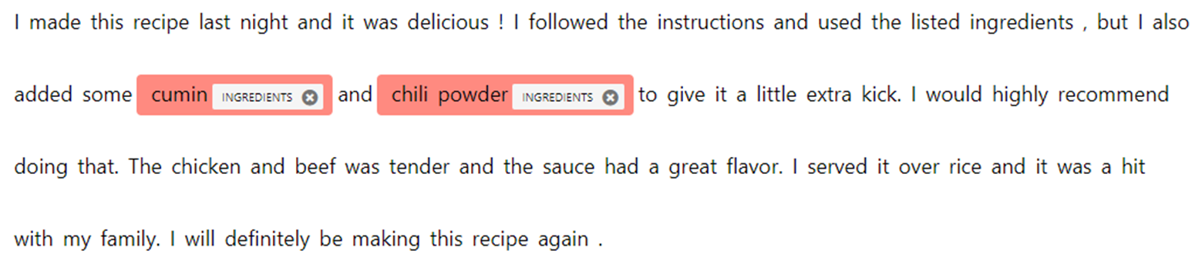
Ingredients Extraction

Slide 36
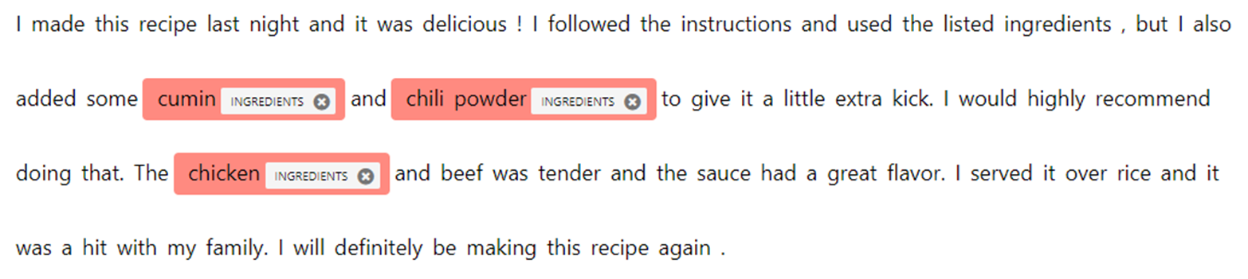
Ingredients Extraction

Slide 37
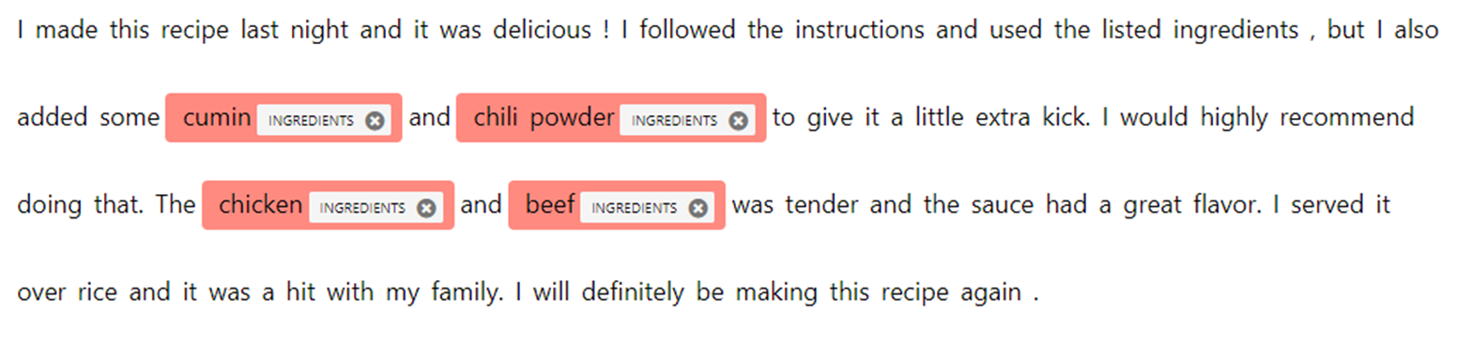
Ingredients Extraction

Slide 38
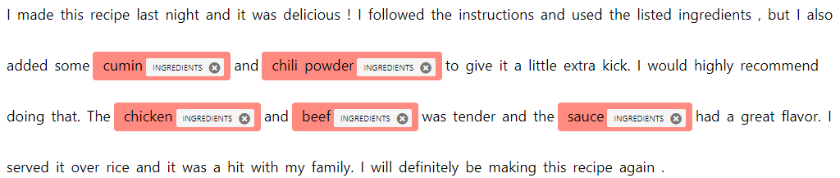
Ingredients Extraction

Slide 39
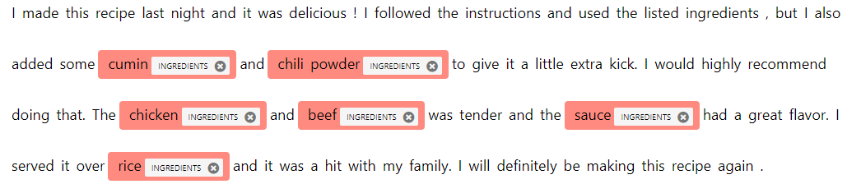
Extraction

Slide 40
Entity Linking Based on Knowledge Graph
Food
Plant
Protein
Grain
Vegetable
Meat
Rice
Cumin
Spice
Chicken
Beef
Chili Powder

Slide 41
Entity Linking Based on Knowledge Graph
Cumin(Plant)
Chili powder(Spice)
Chicken, beef (Meat)
Rice (Cereal grain)

Slide 42


Slide 43
Thank You ☺

